Slide 1
Usability and UX
Imran Mahmud

Slide 2
Usability
Usability is the ease of use and learnability of a human-made object such as a tool or device. In software engineering, usability is the degree to which a software can be used by specified consumers to achieve quantified objectives with effectiveness, efficiency, and satisfaction in a quantified context of use.

Slide 3
System usability scale (SUS)
SUMI (Software Usability measurement inventory)
QUIS (Questionnaire for user interaction satisfaction)

Slide 4
SUS questionnaire
I think that I would like to use this system frequently.
I found the system unnecessarily complex.
I thought the system was easy to use.
I think that I would need the support of a technical person to be able to use this system.
I found the various functions in this system were well integrated.
I thought there was too much inconsistency in this system.
I would imagine that most people would learn to use this system very quickly.
I found the system very cumbersome to use.
I felt very confident using the system.
I needed to learn a lot of things before I could get going with this system.

Slide 5
SUS Score
Scoring SUS
For odd items: subtract one from the user response.
For even-numbered items: subtract the user responses from 5
This scales all values from 0 to 4 (with four being the most positive response).
Add up the converted responses for each user and multiply that total by 2.5. This converts the range of possible values from 0 to 100 instead of from 0 to 40.

Slide 6
SUS result
Recommended Range 0-64 Not acceptable 65-84 Acceptable 85-100 Excellent

Slide 7
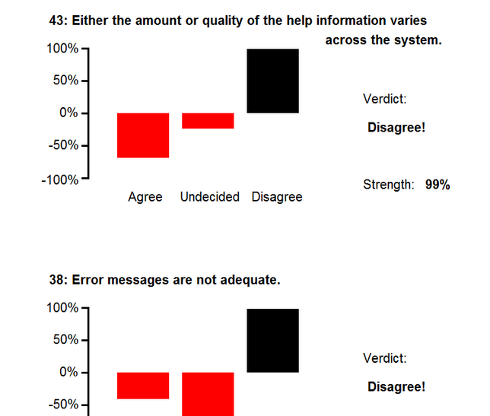
SUMI (50 items)
http://sumi.uxp.ie/en/

Slide 8
QUIS
See the document

Slide 9
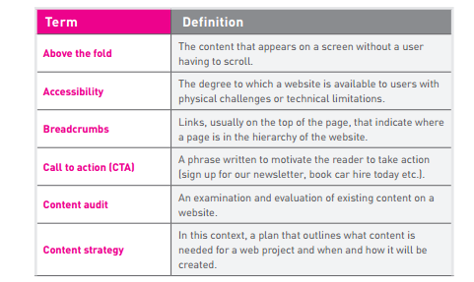
UX Design

Slide 10
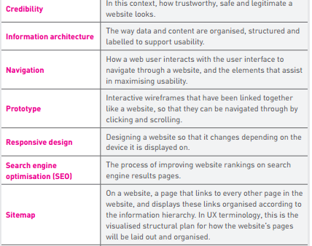


Slide 11
Credibility
Credibility means how trustworthy and legitimate something looks, and is a big consideration for web users when deciding to use your website or not. • Looks – does it look professional and beautiful? • Prominent phone numbers and addresses where they are easy to locate – this assures the visitor that there are real people behind the website, and that they are in easy reach. • Informative and personal ‘about us’ – your customers want to see the inner workings of a company and are especially interested in learning more about the head honchos. Consider including employee pictures and profiles to add personality to the site. • Genuine testimonials – this is a great way to show potential customers what your current customers have to say about your organisation. Trust is vital, and this is one way to encourage it

Slide 12
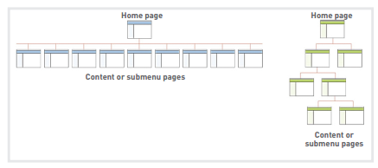
UX step by step
1. Create the site’s basic structure

Slide 13
2. Analyse content
2.1 Structure
Content needs to be written so that users can fnd the information they need as quickly as possible. The chapter on Writing for Digital will cover this in more detail. • Highlighting or bolding key phrases and words • Using bulleted lists • Using paragraphs to break up information • Using descriptive and distinct headings

Slide 14
2.2 Hierarchy On the page, use an inverted pyramid style for your copy. The important information should be at the top of the page, to make for easy scanning. The heading comes first, the largest and boldest type on the page. The subheading follows this, and then the content is presented in a descending scale of importance.

Slide 15
2.3. Relevance Above all, the content on the page must be relevant to the user and the purpose of the page itself. If a user clicks to read about a product but ends up on a page with content about the company, their experience is going to be tarnished.

Slide 16
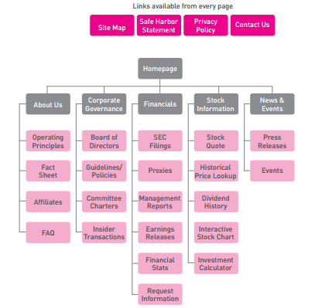
3. Create a sitemap

Slide 17

4. Build the navigation
Where am I?
How did I get here?
Where can I go next?
How to I get home?

Slide 18
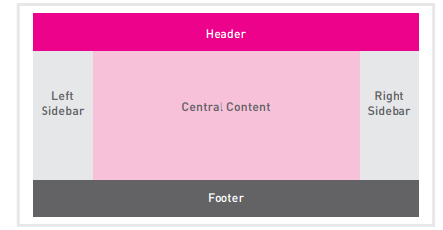
5. Create the Layout

Slide 19
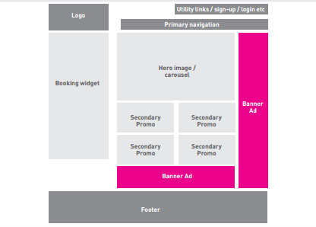

Slide 20
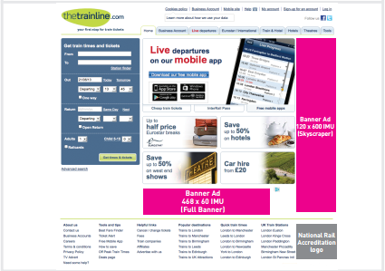

Slide 21
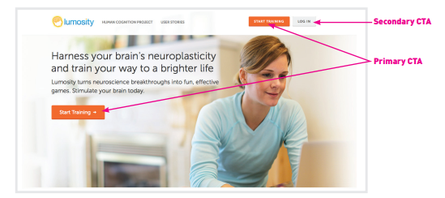
6. Assemble the other elements

Slide 22
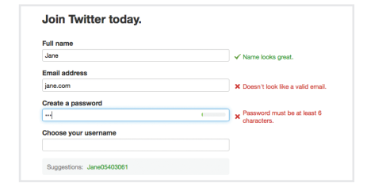
Validation

Slide 23
Web Testing
Broken Link
Load testing

Slide 24
